Slide 1

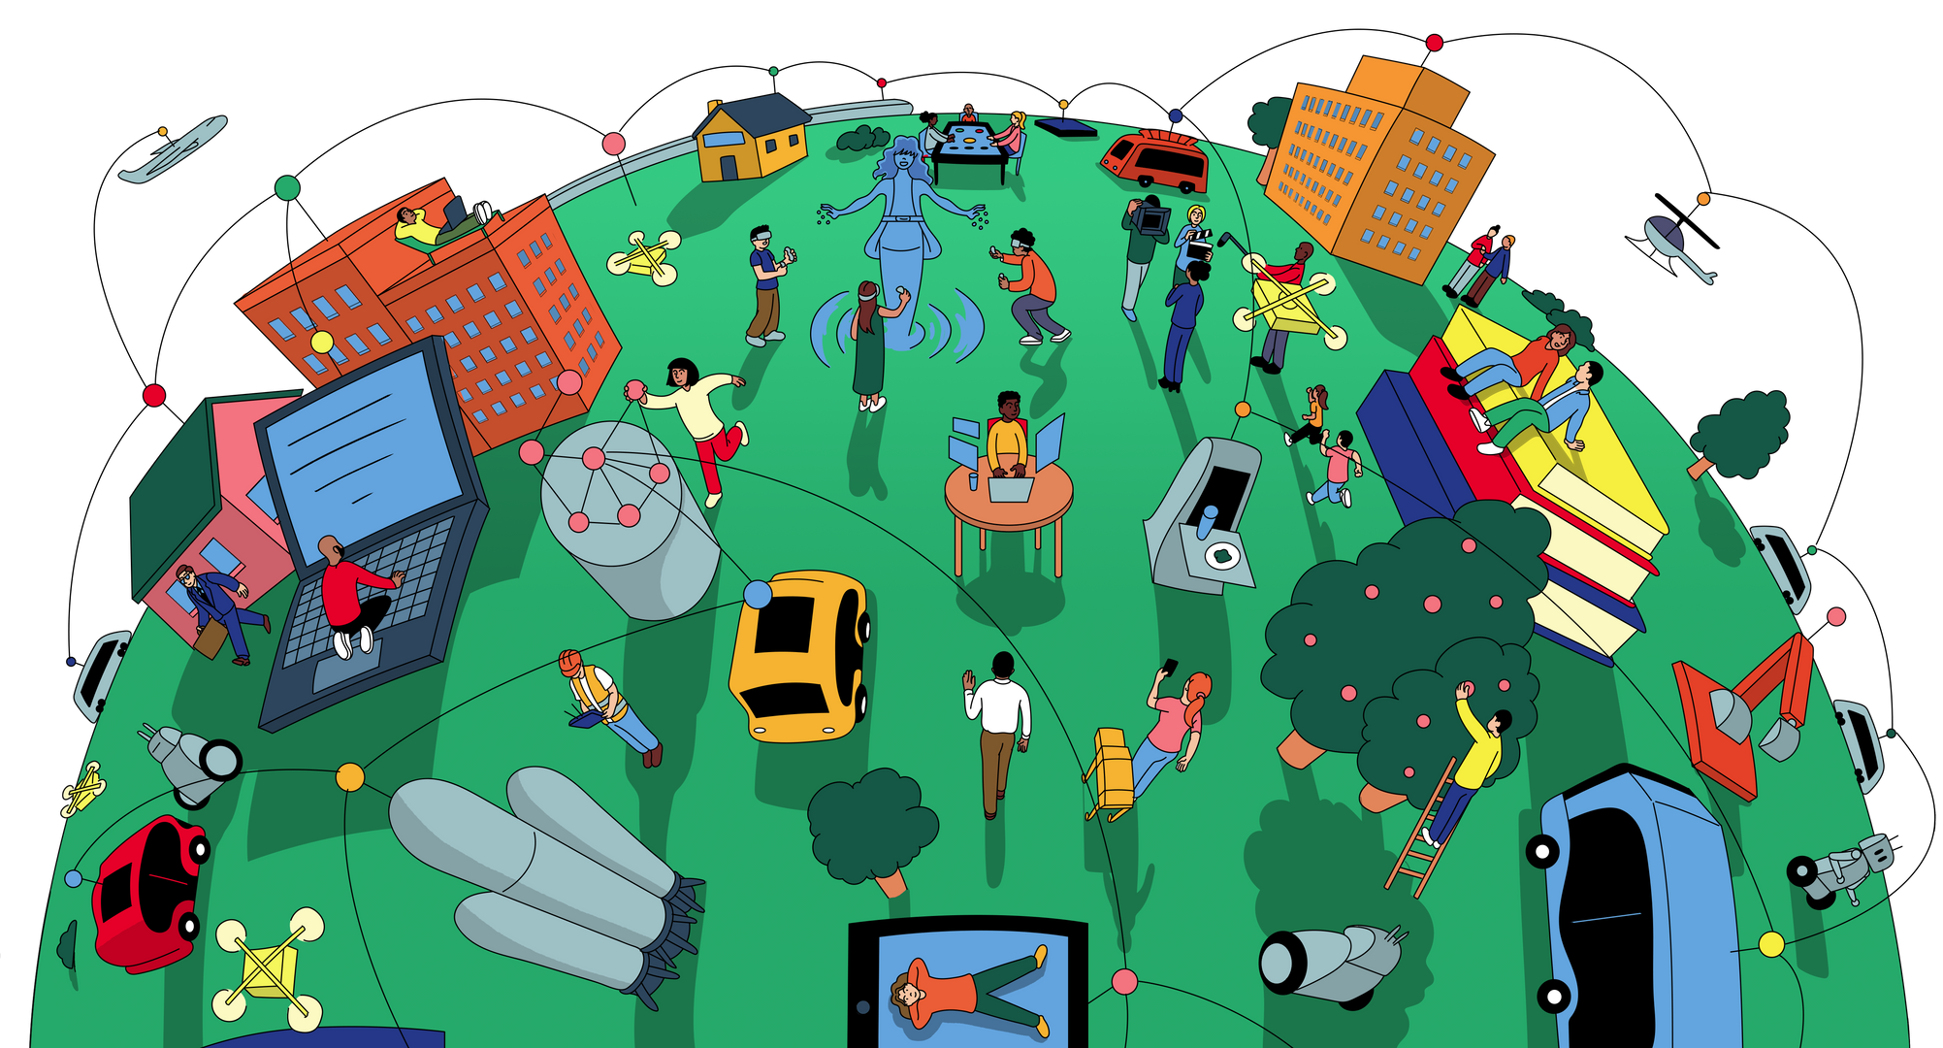
x
AI & Human Relationships
AI Snapshots for
High School ELA

Slide 2
x
Table of Contents
About these AI Snapshots
3
Mapping Connection
Implementation Guidance
Activity Slides
5
6
12
The AI Effect
Implementation Guidance
Activity Slides
18
19
25
Appendix
34

Slide 3

x
What are these AI Snapshots about?
This AI Snapshot series helps students explore AI's impact on human relationships through quick, engaging ELA activities that build critical thinking and authentic connection.
Start Here!
Mapping Connection
Students create a visual graph of their daily connection patterns and identify how technology influences their relationships.
Time: 15-20 minutes
The AI Effect
Students sort AI scenarios by their impact on relationships and develop personal guidelines for AI use.
Time: 15-20 minutes

Slide 4
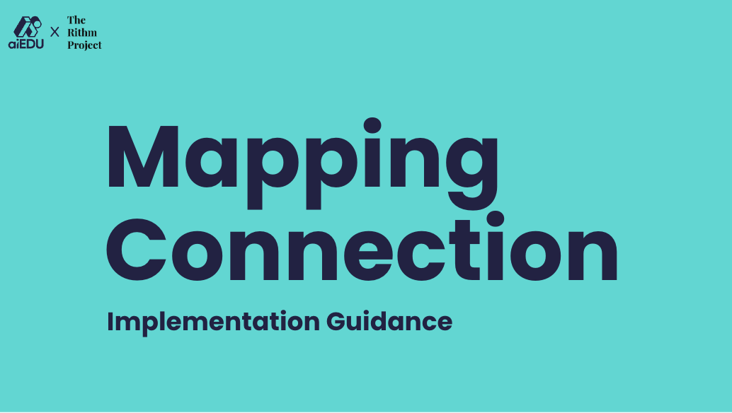


x
Anatomy of a Snapshot
Each AI Snapshot includes everything you need to facilitate with confidence.
See speaker notes for more detailed guidance!
Implementation guidance with tips for facilitation, differentiation, and curriculum integration.
Student-facing activity slides with prompts and discussion questions.

Slide 5
x
Mapping Connection

Slide 6
x
Mapping Connection
Implementation Guidance

Slide 7
x
About Mapping Connection
What Students Do
Create a visual map of daily connection patterns and identify technology's influence on relationships.
Why It Matters
Builds awareness of how AI shapes daily interactions.
See speaker notes for learning objectives, standards alignment, and materials.
Notes:
Overview: Students will visually map and reflect on their state of connection throughout a day, identifying moments influenced by technology (including AI-driven tools), and will present their findings with clear reasoning and supporting evidence to demonstrate how AI shapes their personal and community interactions.
Learning Objective: Students will visually map and reflect on their state of connection, identify technology's influence (including AI), and present findings clearly to demonstrate how AI shapes interactions.
ELA Standards:
CCSS.ELA-LITERACY.SL.9-10.1 (or 6-8 equivalent): Initiate and participate effectively in collaborative discussions on grades 9-10 topics, texts, and issues
CCSS.ELA-LITERACY.SL.9-10.4 Present information, findings, and supporting evidence clearly, concisely, and logically such that listeners can follow the line of reasoning.
aiEDU Competencies:
1a (Recognize AI Systems)
2a (Identify/address biases)
2c (Be continuously curious about AI’s influence)
Materials:
a half-sheet of directions (print two-sided) and
a graph to map and annotate their day
two color pens or pencils
Want to learn more?
Listen to this episode of the Class Disrupted podcast: How AI is Changing How Young People Connect

Slide 8
Getting Ready for Mapping Connection
x
1
2
3
Download
Internalize learning objective and slide speaker notes. Create a connection graph.
Plan
Prepare personal example, discussion prompts, reflection questions.
Gather
Connection graph templates, colored pens, chart paper for gallery walk.
See activity slide speaker notes for detailed facilitation guidance.

Slide 9
x
Facilitating Mapping Connection
Launch Moves
Model vulnerability: Share your own connection graph first.
Activity Pivots
If students finish early: "Add symbols or annotations to show what specific technology was involved."
Closing Strong
Gallery walk protocol: "Leave one sticky note observation about patterns you notice across all graphs."
See speaker notes for more!
Notes:
Launch Moves:
Normalize all patterns: "Straight lines or roller coasters—both are valuable data"
Set vulnerability tone: "We're collecting honest data about our real experiences"
Mid-Activity Pivots:
Early finishers: Add symbols showing specific technology involved
Provide sentence starters: "This morning I felt ___ because ___"
Closing Strong:
Reflection prompt: "What surprised you about your pattern?"
Follow-up questions: "What role did AI play in your most connected/disconnected moments?"

Slide 10
x
Supporting All Learners
For Targeted Scaffolds
Simplify time chunks: Map just morning, afternoon, evening instead of hourly
For Extensions
Compare contexts: Create separate graphs for weekday vs. weekend patterns
For Multilingual Learners
Pre-teach vocabulary: connected, disconnected, peak, valley
See speaker notes for more!
Notes:
For Targeted Scaffolds:
Color-code emotions: Assign red for disconnected, green for connected, yellow for neutral
Provide sentence starters: "At [time], I felt [emotion] because [reason]"
For Extensions:
Interview extension: Survey family members about their connection patterns and compare generational differences
Data analysis: Calculate personal "connection averages" and identify peak/valley patterns
For Multilingual Learners:
Cultural bridges: Invite students to share how connection is expressed in their home cultures
Visual supports: Use emoji or simple drawings instead of words for connection levels

Slide 11
x
Beyond the Snapshot
ELA Connections
Personal narrative writing: Use graphs as inspiration for essays about technology's impact on relationships
Follow-Up Ideas
Weekly tracking: Students keep connection journals and notice pattern changes
See speaker notes for more!
Notes:
ELA Connections:
Digital citizenship units: Perfect opener for discussions about healthy technology use
Argumentative writing: Students argue for/against specific technology practices using their data as evidence
Follow-Up Ideas:
Family conversations: Share graphs at home and discuss family technology agreements
Peer interviews: Students interview classmates about their most/least connected moments

Slide 12
x
Mapping Connection
Activity Slides

Slide 13

x
1-2 mins
Mapping Connection
Think about a typical day.
When do you feel most connected to others?
When do you feel least connected?
Notes:
Say: "Think about your typical day. When do you feel most connected to other people – friends, family, your community? When do you feel least connected? Today, we're going to map out these feelings of connection and explore how technology, including AI, might be influencing those moments."

Slide 14
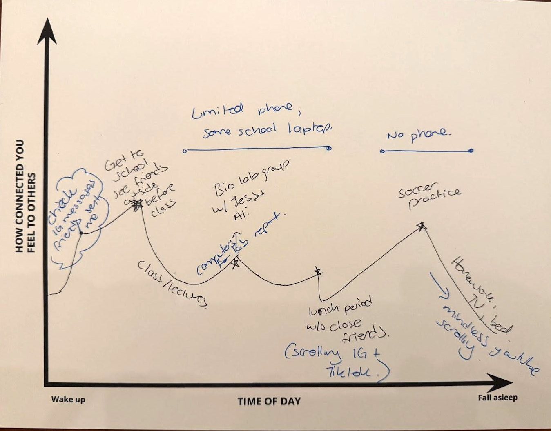
x
Part I: Create Your Graph
3-4 mins
Plot Your Day: Create a line graph showing when you felt more or less connected to others.
Label Peaks and Valleys: What was happening at high and low points?
Mark Tech Use: Highlight when you used technology (note the apps)
Mapping Connection
Notes:
Say: "First, you'll create a visual map of your connection levels over one day this past week. Look at the handout. The vertical axis is 'How Connected You Feel,' and the horizontal axis is 'Time of Day'."
Say: "Use one color pen. Plot points on the graph to show how connected you felt at different times, from waking up to going to sleep. Connect the points to make a line graph."
Say: "Next, label the highest points (peaks) and lowest points (valleys) on your graph. Add short notes explaining what was happening during those moments – where were you, who were you with, what were you doing?"
Say: "Now, take your second color pen. Go back over your graph and highlight the moments when you were using technology. Next to these highlighted parts, write down the specific apps or tools you were using and what you were doing with them. Think about social media, games, streaming services, communication apps, homework tools – some of these might use AI."
Look For: Students accurately plotting points, labeling peaks/valleys with context, and identifying/labeling technology use with a different color.

Slide 15
x
Part II: Share Your Chart
3-4 mins
Mapping Connection
With a partner, discuss:
When did you feel most connected/least connected?
Where were you during these moments?
What tech did you use?
Notes:
Say: "Now, pair up or get into trios. Take turns sharing your connection graphs. As you share, talk about these points:"
Ask:
When did you feel most connected/least connected?
Where were you during these moments?
What tech did you use?
Look For: Students actively listening and sharing specific moments from their graphs, linking connection levels to activities and tech use.

Slide 16
x
Part III: Define Lessons
3-4 mins
As a group:
What are common connection/disconnection times?
How might graphs look different pre-smartphones?
Which apps helped or hurt connection?
What’s one tech change you’ll make this week?
Mapping Connection
Notes:
Say: "After everyone in your small group has shared, discuss these questions together."
Ask:
What are common connection/disconnection times?
How might graphs look different pre-smartphones?
Which apps helped or hurt connection?
What’s one tech change you’ll make this week?
Look For: Deeper reflection on patterns, comparisons between tech/no-tech scenarios, identification of specific tech impacts (positive and negative), and personal takeaways or intentions.

Slide 17
x
1 min
Mapping Connections
Our sense of connection shifts naturally from moment to moment.
AI can impact these shifts in positive and negative ways.
Notes:
Say: "Mapping our connection helps us see how our feelings and relationships shift throughout the day, and how technology, including AI-driven tools, plays a role. Being aware of these patterns is the first step to making intentional choices about how we connect."

Slide 18
x
The AI
Effect

Slide 19
x
The AI Effect
Implementation Guidance

Slide 20
x
About The AI Effect
What Students Do
Sort AI scenarios by impact on connection and debate ethical considerations.
Why It Matters
Develops critical thinking beyond simple "good/bad" AI judgments.
See speaker notes for learning objectives, standards alignment, and materials.
20 additional scenarios in appendix.
Notes:
Overview: Students will evaluate a range of AI use cases by sorting them based on their impact on human connection. Through group discussion and reflection, students will compare perspectives, debate ethical considerations, and distill shared principles. They will articulate personal intentions for engaging with AI in ways that support healthy relationships.
Learning Objective: Students will evaluate AI use cases for their impact on human connection, debate ethical considerations, compare perspectives, and articulate intentions for using AI to support relationships.
Materials:
AI Scenario Cards (In slides, see Appendix for more)
"What if?" cards
Sorting Mats
ELA Standards:
CCSS.ELA-LITERACY.SL.9-10.1 (or 6-8 equivalent): Initiate and participate effectively in collaborative discussions on grades 9-10 topics, texts, and issues
CCSS.ELA-LITERACY.SL.9-10.4 Present information, findings, and supporting evidence clearly, concisely, and logically such that listeners can follow the line of reasoning.
aiEDU Competencies:
1a (Recognize AI Systems)
2a (Identify/address biases)
2c (Be continuously curious about AI’s influence)
Want to learn more?
Listen to this episode of the No Stupid Questions podcast: Can AI Companions Replace Human Connection?
Read this article from The Rithm Project: Will AI Strengthen or Erode Human-to-Human Relationships?

Slide 21
x
Getting Ready for The AI Effect
1
2
3
Download
Internalize learning objective and slide speaker notes. Practice sorting scenarios.
Plan
Select AI scenarios (including from Appendix), determine facilitation plan
Gather
Print scenario cards, prepare sorting mats, organize extension cards.
See activity slide speaker notes for detailed facilitation guidance.

Slide 22
x
Facilitating The AI Effect
Launch Moves
Set discussion norms: "We're exploring gray areas—it's okay to be unsure or change your mind"
Activity Pivots
If debate gets heated: Assign "Devil's Advocate" roles to argue opposite viewpoints respectfully
Closing Strong
Physical movement: Students move to corners (Supports/Erodes/
Depends) for each scenario
See speaker notes for more!
Notes:
Launch Moves:
Prime with experience: "Think of when AI or technology helped or hurt a relationship"
Emphasize complexity: "Our goal isn't agreement—it's deeper thinking"
Activity Pivots:
If sorting stalls: Introduce "What if?" cards to add complexity
Respectful disagreement: "Say 'I disagree with that idea because...' not 'You're wrong'"
Closing Strong:
Synthesis question: "What patterns do you notice in the scenarios that 'depend'?"
Personal application: "How might you apply this thinking to AI decisions in your own life?"

Slide 23
x
Supporting All Learners
For Targeted Scaffolds
Graphic organizers: Provide T-charts for weighing pros/cons before sorting decisions
For Extensions
Scenario creation: Students design their own AI relationship scenarios for peers to sort
For Multilingual Learners
Vocabulary support: Pre-teach support, erode, authentic, scenario, impact with visual examples
See speaker notes for more!
Notes:
For Targeted Scaffolds:
Written processing: Allow written responses for students uncomfortable with verbal debate
Partner support: Pair students for initial sorting before group discussion
For Extensions:
Policy development: Create family or classroom guidelines for AI use based on sorting insights
Research extension: Investigate real-world examples of each scenario type
For Multilingual Learners:
Cultural connections: Use examples from students' cultural contexts when discussing relationship scenarios
Simplified language: Provide scenario cards with reduced complexity language

Slide 24
x
Beyond the Snapshot
ELA Connections
Literature study: Use as a companion to dystopian novels like Fahrenheit 451 or The Circle
Follow-Up Ideas
Family AI audit: Students evaluate AI use in their households using the sorting framework
See speaker notes for more!
Notes:
ELA Connections:
Argumentative writing: Students write position papers on AI's impact on relationships using sorting insights
Research projects: Launch point for inquiry into AI ethics, digital wellness, or technology's social impact
Follow-Up Ideas:
Peer mentoring: Older students teach younger students to think critically about AI relationships
Community action: Students propose AI relationship guidelines for their school or community

Slide 25
x
The AI Effect
Activity Slides

Slide 26
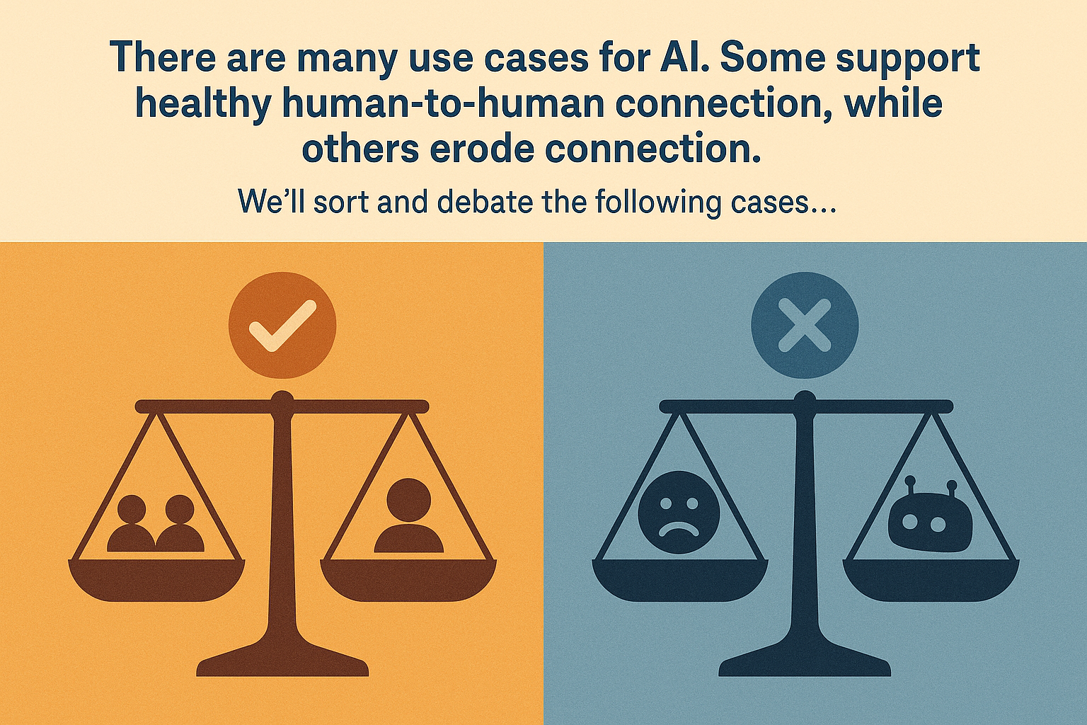
x
1-2 mins
The AI Effect
How might AI help human connection?
How might AI hurt human connection?
Notes:
Say: "Artificial intelligence is used in many ways we might not even realize. Some uses might help bring people closer together, while others might create distance or weaken relationships."
Say: "Today, we're going to look at several specific examples – AI scenarios – and debate their effect on human connection. Our goal is to think critically about how we want AI to function in our relationships."
Ask: "Just off the top of your head, can you think of a way AI might help human connection? How might it hurt?" (Brief brainstorm).

Slide 27
x
3-4 mins
Step 1: Sort & Explain
The AI Effect
Take turns placing each scenario card into a column.
Explain why you think the scenario should go there.
Supports
Erodes
Depends
Notes:
Say: "In your groups, you have three AI scenario cards. Your task is to decide where each scenario belongs: Does it generally Support human connection, Erode (wear away) human connection, or It Depends on the situation?"
Say: "Take turns reading a scenario card aloud. Place it in one of the columns (Supports, Erodes, Depends). Most importantly, explain your reasoning to your group. Why do you think it belongs there?"
Students sort and discuss scenarios.
Look For: Students engaging with the scenarios, placing cards thoughtfully, and articulating clear justifications for their placements. Listen for differing opinions and the reasoning behind them.

Slide 28
x
3-4 mins
Step 2: “What if…”
The AI Effect
Group members may use one “What if?” card to challenge or complicate the scenario.
Make it count!
What if the AI is just helping spark ideas, not replacing anyone?
What if someone uses this tool every day and stops talking to real people?
Notes:
Say: "As you discuss each scenario, anyone in the group can use one 'What if?' card. This card is your chance to challenge the initial placement or complicate the discussion."
Say: "For example, if someone places a scenario in 'Supports,' you might ask, 'What if this technology is used dishonestly?' Or if it's in 'Erodes,' you might ask, 'What if this is the only way someone can connect?' Make your 'What if?' count!"
Look For: Students using "What if?" questions to introduce nuance, alternative perspectives, or potential negative/positive consequences not initially considered.

Slide 29
x
3-4 mins
Step 3: Reflect & Discuss
The AI Effect
What patterns do you notice in the Support vs. Erode columns?
Are there any “Erode” examples you’d still use? Why?
How did the “What if?” challenges shift your thinking?
What personal takeaways do you have? (Is there anything you want to try, change, or avoid?)
Notes:
Say: "Okay, look at where your scenarios ended up after your discussion and 'What if?' challenges. Now, let's reflect as a group:"
Ask:
What patterns do you notice in the Support vs. Erode columns?
Are there any “Erode” examples you’d still use? Why?
How did the “What if?” challenges shift your thinking?
What personal takeaways do you have? (Is there anything you want to try, change, or avoid?)
Look For: Groups identifying trends (e.g., scenarios involving deception often 'erode', scenarios aiding communication often 'support' or 'depend'), grappling with the ethics of potentially harmful but tempting AI uses, acknowledging shifts in perspective, and formulating personal intentions.

Slide 30
x
3-4 mins
AI Scenario #1
The AI Effect
“Preparing to have a tough conversation by practicing it first with an AI bot.”
Does this support human connection, erode human connection, or it depends?

Slide 31
x
3-4 mins
AI Scenario #2
The AI Effect
“Using a friend’s photo to create a deep fake video as a joke.”
Does this support human connection, erode human connection, or it depends?

Slide 32
x
3-4 mins
AI Scenario #3
The AI Effect
“Generating AI bedtime stories for a younger sibling, using personal information about your family to customize them.”
Does this support human connection, erode human connection, or it depends?

Slide 33
x
1 min
The AI Effect
AI tools can both support and erode human connection.
Being aware of their impact can help us make informed choices about their use.
Notes:
Say: "Evaluating AI's impact isn't always simple. Many uses have potential benefits and risks. Discussing these scenarios helps us develop clearer principles for how we want AI to interact with our human connections."

Slide 34
x
x
Appendix

Slide 35
Supports
Erodes
Depends

Slide 36
What if someone uses this tool every day and stops talking to real people? | What if the AI is just helping spark ideas, not replacing anyone?
What if this AI tool didn't exist - what skills would the person need to develop? | What if this AI tool makes someone feel more confident versus more insecure?

Slide 37
What if a 12-year-old uses this versus a 40-year-old? | What if millions of people start using this AI tool the same way?
What if this AI tool is used with family members versus strangers? | What if other people find out this person is using AI for this?

Slide 38
x
3-4 mins
AI Scenario #4
The AI Effect
“Creating a holographic version of yourself to attend a far-away family gathering.”
Does this support human connection, erode human connection, or it depends?

Slide 39
x
3-4 mins
AI Scenario #5
The AI Effect
“Letting AI auto-reply to your friends’ messages when you’re feeling overwhelmed.”
Does this support human connection, erode human connection, or it depends?

Slide 40
x
3-4 mins
AI Scenario #6
The AI Effect
“Asking AI to write a heartfelt speech for a friend’s special occasion.”
Does this support human connection, erode human connection, or it depends?

Slide 41
x
3-4 mins
AI Scenario #7
The AI Effect
“Talking to an AI preserved version of a beloved deceased relative or ancestor.”
Does this support human connection, erode human connection, or it depends?

Slide 42
x
3-4 mins
AI Scenario #8
The AI Effect
“Generating an AI-created message to apologize to a friend after a fight.”
Does this support human connection, erode human connection, or it depends?

Slide 43
x
3-4 mins
AI Scenario #9
The AI Effect
"Using AI to impersonate someone online and post mean things in their name."
Does this support human connection, erode human connection, or it depends?

Slide 44
x
3-4 mins
AI Scenario #10
The AI Effect
“Making AI version of your favorite movie/book/tv character to chat with when you are bored.”
Does this support human connection, erode human connection, or it depends?

Slide 45
x
3-4 mins
AI Scenario #11
The AI Effect
“Having an AI version of you sign on to class.”
Does this support human connection, erode human connection, or it depends?

Slide 46
x
3-4 mins
AI Scenario #12
The AI Effect
“Using AI to analyze all of your personal data (emails, texts, search history), to recommend romantic partners.”
Does this support human connection, erode human connection, or it depends?

Slide 47
x
3-4 mins
AI Scenario #13
The AI Effect
“Using a hidden AI companion in your ear to prompt you with topics, questions, and responses while you’re in conversation with someone.”
Does this support human connection, erode human connection, or it depends?

Slide 48
x
3-4 mins
AI Scenario #14
The AI Effect
“Using AI to rate your physical appearance and offer tips to improve it.”
Does this support human connection, erode human connection, or it depends?

Slide 49
x
3-4 mins
AI Scenario #15
The AI Effect
“Tasking AI with tracking special moments in your friends’ lives and sending personalized messages and gifts.”
Does this support human connection, erode human connection, or it depends?

Slide 50
x
3-4 mins
AI Scenario #16
The AI Effect
“Engage in AI-simulations that help you see the world/ scenarios from someone else’s perspective.”
Does this support human connection, erode human connection, or it depends?

Slide 51
x
3-4 mins
AI Scenario #17
The AI Effect
“Participating in a virtual AI-facilitated group therapy session.”
Does this support human connection, erode human connection, or it depends?

Slide 52
x
3-4 mins
AI Scenario #18
The AI Effect
“Using a tool to “optimize” your social media pictures.”
Does this support human connection, erode human connection, or it depends?

Slide 53
x
3-4 mins
AI Scenario #19
The AI Effect
“Venting frustrations to an AI bot.”
Does this support human connection, erode human connection, or it depends?

Slide 54
x
3-4 mins
AI Scenario #20
The AI Effect
“Create a memory bank that you and your friends share and can “look into” for years to come.”
Does this support human connection, erode human connection, or it depends?

Slide 55
x
3-4 mins
AI Scenario #21
The AI Effect
“Using AI that tracks your emotions and translates them into visual art that others can see (like a public “mood ring”).”
Does this support human connection, erode human connection, or it depends?

Slide 56
x
3-4 mins
AI Scenario #22
The AI Effect
“Letting an AI summarize your friend’s texts when you don’t feel like reading long messages.”
Does this support human connection, erode human connection, or it depends?

Slide 57
x
3-4 mins
AI Scenario #23
The AI Effect
“Asking an AI chatbot for advice on dealing with feelings of loneliness.”
Does this support human connection, erode human connection, or it depends?

Slide 58
x
3-4 mins
AI Scenario #24
The AI Effect
"Using AI to create fake screenshots of conversations to make someone look bad."
Does this support human connection, erode human connection, or it depends?

Slide 59
x
3-4 mins
AI Scenario #25
The AI Effect
“Using AI to translate a message for someone who speaks another language.”
Does this support human connection, erode human connection, or it depends?

